Slide 1
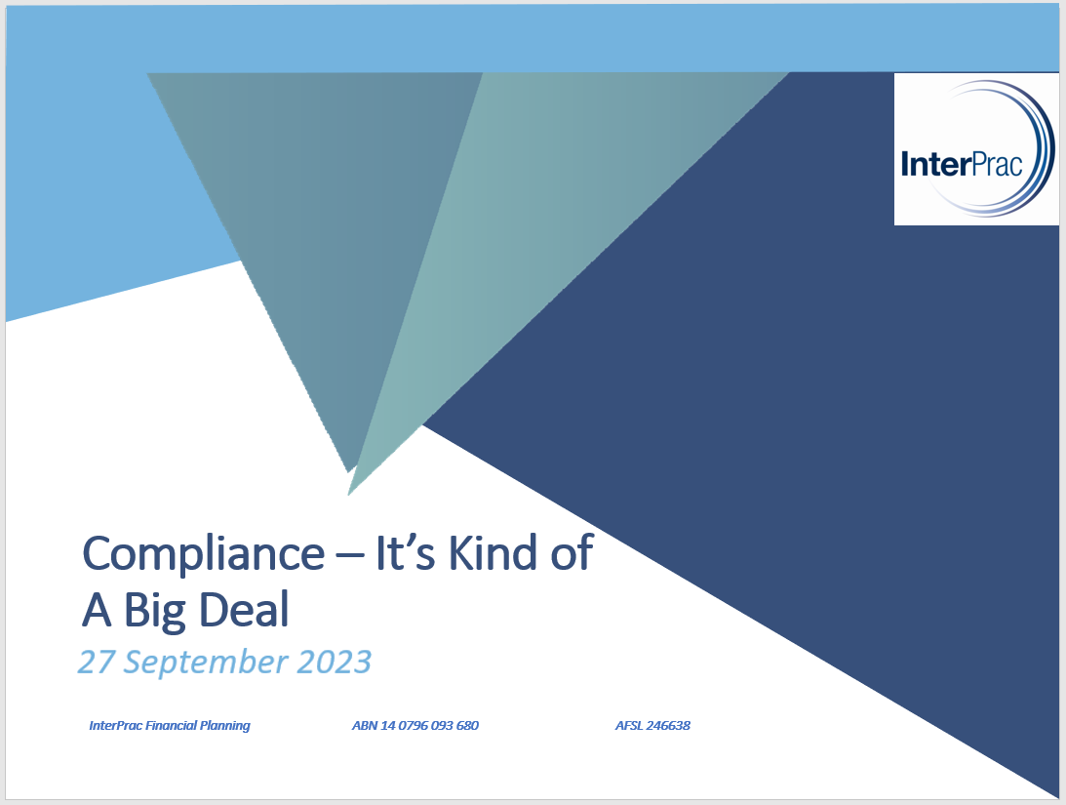


Compliance – It’s Kind Of A Big Deal
27 September 2023

Slide 2
Compliance – It’s Kind Of A Big Deal
Today’s Agenda
License and Industry Update
  What is happening in the world of compliance
SOA V ROA
  When can an ROA be provided
FDS Refresher
  Including documentation required
Reviews
  What is a review and how to demonstrate you have met your obligations
Sole Purpose
  Reminder that this is still a requirement
Alternative Products and Strategies
  Refresher on file requirements to meet this requirement
Questions

Slide 3
License & Industry Update
AML – Digital Identification
Holley Nethercote has provided us guidance on the use of Digital Identification
You can use a Digital Identification provider to assist with client ID verification
It does not eliminate the need to complete the AML FSC ID Form
You still cannot verify ID virtually
You cannot use the Digital Identification document to certify ID
Digital Identification is being used by some providers as an alternative to certified ID
Experience Pathway
Passed through Parliament recently
Partnering with Kaplan will assist us in assessing eligibility
We will need to wait for ASIC to release a reg. guide for more detail
QAR
No recent updates and we don’t expect anything to take place this year but most likely mid 2024
We still believe FDS’ will go
Changes to SOA’s

Slide 4
License & Industry Update
ASIC Levy
Lobbying to the AIOFP unfortunately hasn’t yielded a successful outcome to have the cap reinstated
5 payments over 5 months
Complaints
Recent complaints have seen clients complain about lack of service and monitoring of portfolios
If client is not ongoing advice, ensure the client is clear what the impacts may be
Breaches
ASIC has flagged its intention to conduct a targeted surveillance of licensees
Ensure you report to us, and we will decide how it progresses
ROA/SOA and Text Updates
Recent changes come off the back of Fourth Line feedback
ROA - Scoping

Slide 5
License & Industry Update
Time Critical Advice
Must be approved by compliance
Very limited instances where TCA can be used
Referral Relationships
If you are participating in a referral relationship it must be disclosed in your FSG and SOA
Reach out to your Compliance Manager
Referral Agreement required
Wholesale Advice
New Wholesale policy being developed
Must give Retail Advice when treating the client as Wholesale is not appropriate
CPD Points
Expectation is that you are a quarter of the way through your requirements
PD Day
Registrations open

Slide 6
SOA or ROA
What is an ROA?
A ROA is an advice document that can be used to provide further advice to clients. The further advice must be in relation to the strategies and recommendations previously provided to the client via a Statement of Advice (SOA).
Conditions to be met to use an ROA
The client has previously received an SOA from you. ROAs must always refer to this SOA and cannot refer to another ROA.
The SOA sets out the client’s relevant personal circumstances in relation to the advice.
The client’s relevant personal circumstances are not significantly different to that within the original SOA, and you have made reasonable enquiries to determine this.
The subject matter and scope of the further advice is in line with the advice provided in the SOA.
The basis of the further advice is not significantly different to the basis within the SOA.
The SOA was provided to the client less than 5 years ago. However, If you believe that the use of an ROA remains appropriate beyond this 5 year timeframe, please discuss this situation with your compliance manager.

Slide 7
SOA or ROA
How do you determine what is a significant change?
The legislation does not define what is meant by significant in relation to a client’s personal circumstances as well as the basis of the advice. Every client’s circumstances are different and individual and therefore the assessment of whether a change is significant may differ from client to client.
Guidance – Relevant Personal Circumstances
The following are examples of changes to a client’s relevant personal circumstances that may lead to a determination that a significant change has occurred since the original SOA:
The client’s employment status has changed or will change. This may include situations such as redundancy, parental leave, they move from self-employed to employed, etc.
The clients marital/family status has changed. This can include marriage, separation/divorce.
The client has had a change to their financial dependents.
The client’s asset or debt position has changed. This may include the purchase of an investment, addition of debt, inheritance, etc.
We do note however that the following changes will be determined as a significant change and therefore a new SOA must be produced:
The client’s views on risk have changed. This includes a shift of more than one risk profile or a change of preference regarding investments.
The client has permanently retired from the workforce.

Slide 8
SOA or ROA
Guidance – Basis of Advice
The legislation also requires the basis of advice not to be significantly different from that of the SOA. The change to the basis of advice, may be lead from a change to relevant personal circumstances or change to the client’s goals and objectives.
This includes:
A new strategy is being recommended that was not included in the SOA.
A different class of product is being recommended.
Examples of where an ROA would not be appropriate
Significant change to the client’s circumstances
Significant change to the client’s risk profile
Replacement of a product including super to pension or replacement of an insurance product.
A new product or strategy not covered in the original SOA.
Examples of where an ROA would be appropriate
Rebalance a portfolio within an existing product
Slight amendment to a contribution strategy
An ROA no change as part of an annual review
As part of the implementation phase of insurance advice, you may choose to alter your existing recommendations to account for any unforeseen exclusions or loadings. For instance, retain or partially retain the existing cover where no loadings apply.

Slide 9
Ongoing Service Arrangements
Ongoing Service Arrangements (OSA)
An ongoing service arrangement exists where an adviser provides personal advice to retail clients under the terms of an arrangement for a fee that is paid for a period of more than 12 months.
As part of the release of the Financial Sector Reform (Hayne Royal Commission Response No.2) Act 2021, all ongoing service agreements must now be renewed annually instead of the previous 2-year renewal period.
The day on which the arrangement is entered into is referred to as the “Anniversary Day”.
Ongoing Disclosure Requirements
All annual disclosure requirements for clients with an ongoing fee arrangement are met via one document. At Interprac this document is called the Standard Fee Disclosure Statement (FDS) which can be found in the Adviser Resources Center and includes the following:
Fee Disclosure Statement (FDS)
Ongoing Service Arrangement Renewal
It is important that you use our InterPrac FDS template so please download it from the ARC if you don’t have our latest document.
Additionally, the ongoing advice provided to the client must be documented in an advice document, being either an ROA or SOA.

Slide 10
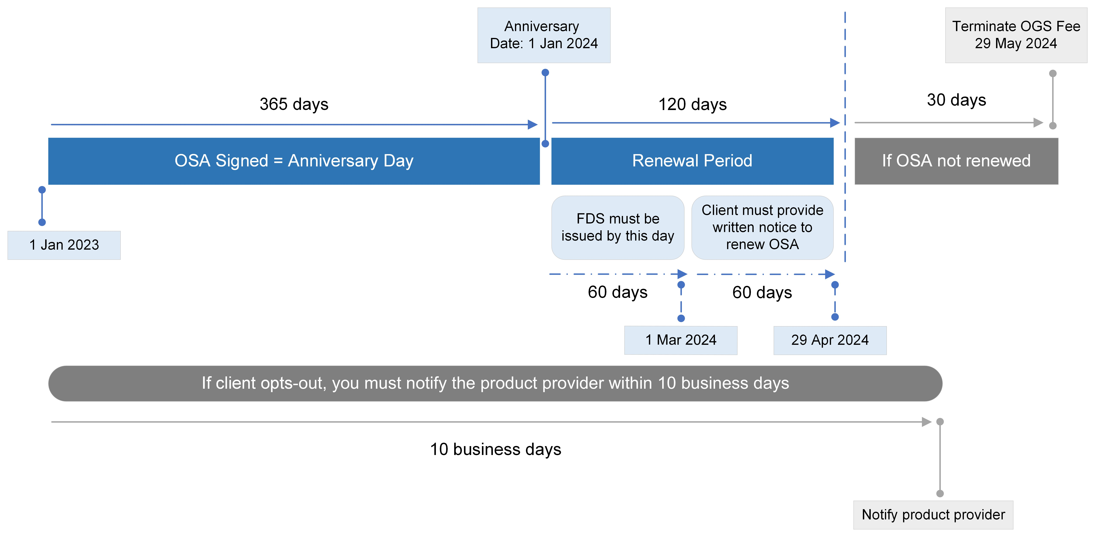
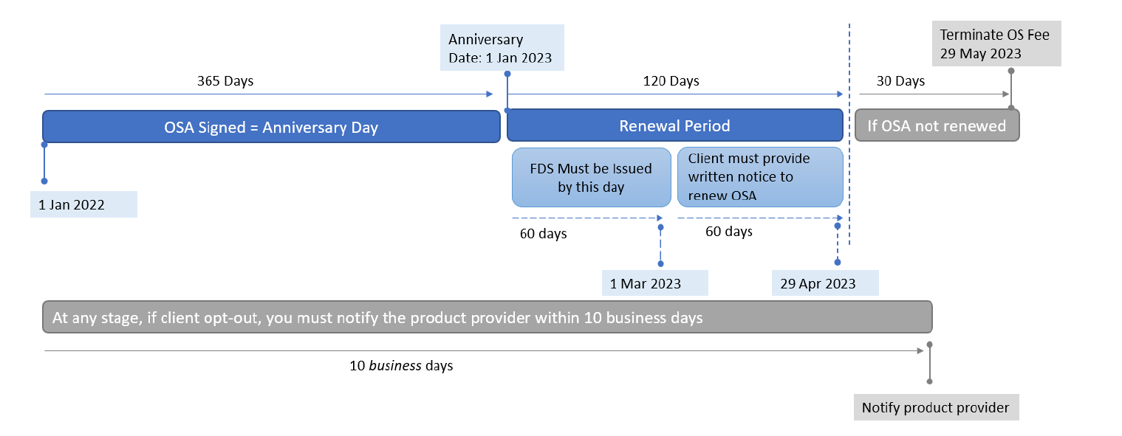
Ongoing Service Arrangements
When must FDS be sent to clients

Slide 11
Ongoing Service Arrangements
Changing the Anniversary Day
The Anniversary Day cannot be changed under the new legislation and cannot be brought forward unlike previous legislation.
In order to effect any change to dates, the OSA must be terminated and then a new OSA re-entered into with the client.
A Terminating OSA: Fee Disclosure Statement document which is in the Adviser Resources Centre and needs to be issued to the adviser and the past 12 months fees as at the termination date needs to be disclosed to the client.
Additional Obligations
Adequate records must be maintained in relation to all OSA obligations and you must ensure that they can be easily ascertained.
Most of the OSA requirements are subject to the penalty provisions under Corporations Act. Where it is identified that a breach has occurred, InterPrac legally has the obligation to formally record and notify ASIC of all breaches.

Slide 12
CLIENT REVIEWS
As you are all aware, if you have a client signed up to an ongoing service program you must review your clients within 12 months of them entering into an agreement.
What is a review ?
How do we evidence that a review has been conducted?
What if an SOA /ROA has not been issued within the 12months ?

Slide 13
CLIENT REVIEWS
What is a Review ?
The review is your meeting with your clients. This is the discussion that determines their current situation , their current needs and more importantly if their have been any significant changes to their circumstances since the original SOA.
Does their initial recommendation still meet their financial objectives
Do they remain on track to meet those objectives or goals
This is your opportunity to show your worth to your clients and highlight the importance of them being on an ongoing service program
Remind them why they came to see you in the first place

Slide 14
CLIENT REVIEWS
How do we evidence that a review has been conducted?
A review can be completed in many different formats inc: face to face, phone meeting, teams /virtual.
It is this meeting with your clients that MUST be conducted before the anniversary date/review date.
Once the meeting has concluded – you have completed your review – your ongoing service obligation for a review has been met. What next?
  you must record your Review meeting in a file note – we have templates available on the ARC
  It is recommended that your file note is titled “Review Meeting” - include date, time, location, attendees
Risk Appetite discussion : Your file must demonstrate that you have had a discussion regarding your clients Risk Profile at least annually ( a file note or a Risk Profile questionnaire) – however a Risk Profile questionnaire must be completed at least every 3 years of your client relationship.
Clients Current Circumstances : The most effective way to evidence that you have confirmed your clients current circumstances is by generating a reverse fact find and updating it, or referring back to the original Fact find. However, detailed commentary on the file note would suffice.
Then:
  you must determine what advice document is required following your review. ROA vs SOA – this must be prepared within a reasonable time after the meeting

Slide 15
CLIENT REVIEWS
What if an SOA /ROA has not been issued within the 12months ?
This is OK
Remember your obligation is to conduct your review meeting within 12 months of your client entering into an ongoing service agreement
Your new SOA or ROA is the advice documentation which you have determined to be required after you conducted your meeting with the client .
I cannot stress enough how important it is for the review meeting to be conducting within the 12 months- as this meeting is your obligation the advice documentation is the outcome of that review so you have not breached any of your obligations by providing the advice document after the review date/or anniversary date.
Please refer to the ARC or speak to your compliance manager if your require any clarification

Slide 16
SOLE PURPOSE TEST
Originally released by APRA in 1998 – 25 years ago
It was introduced to ensure that superannuation funds were maintained solely for the purpose of providing retirement benefits to its members.
Financial Planners play an extremely integral role, and it is important that you are aware of your obligations when it comes to the sole purpose test.
Applies to all superannuation products – accumulation and pension
Care is needed for any fee deduction to a super fund

Slide 17
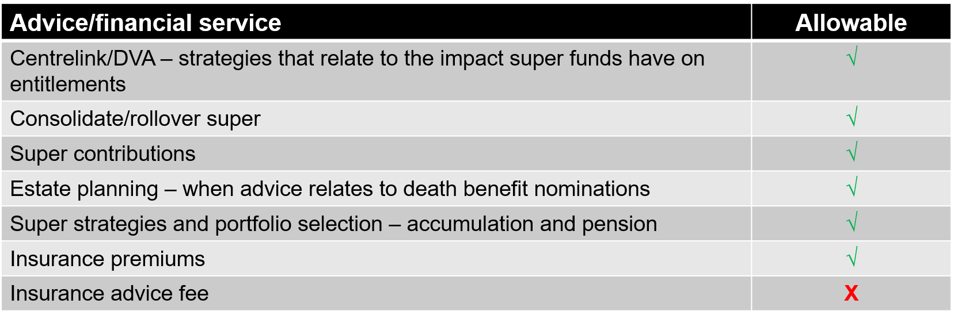
SOLE PURPOSE TEST
Examples of Permitted Scenarios

Slide 18
SOLE PURPOSE TEST
Advice Fees
Fees charged must be apportioned correctly based on the recommendations made in an SOA
There are 2 methods which can be used to determine the fee apportioning :
  1. FUM – apportion based on the account balance
  2. Complexity – time based
  In recent time Super trustees have been requesting documentation to demonstrate the fees charged meet the sole purpose test and in some instances advisers have been made to refund fees
  In order to support advisers to manage their Sole Purpose obligation we have a Checklist available in the ARC as well as our Sole purpose Test and Fee Consent Business Principles.
  NOTE: The checklist must be used in all cases where a fee is deducted from a superannuation or pension account and can act as your evidence

Slide 19
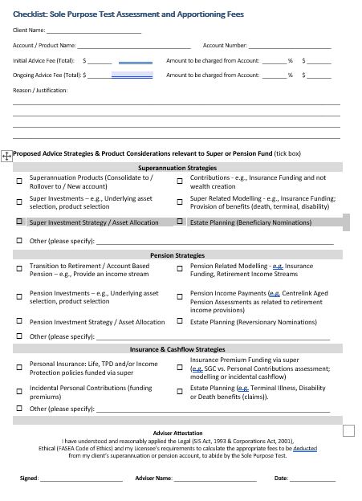

Slide 20
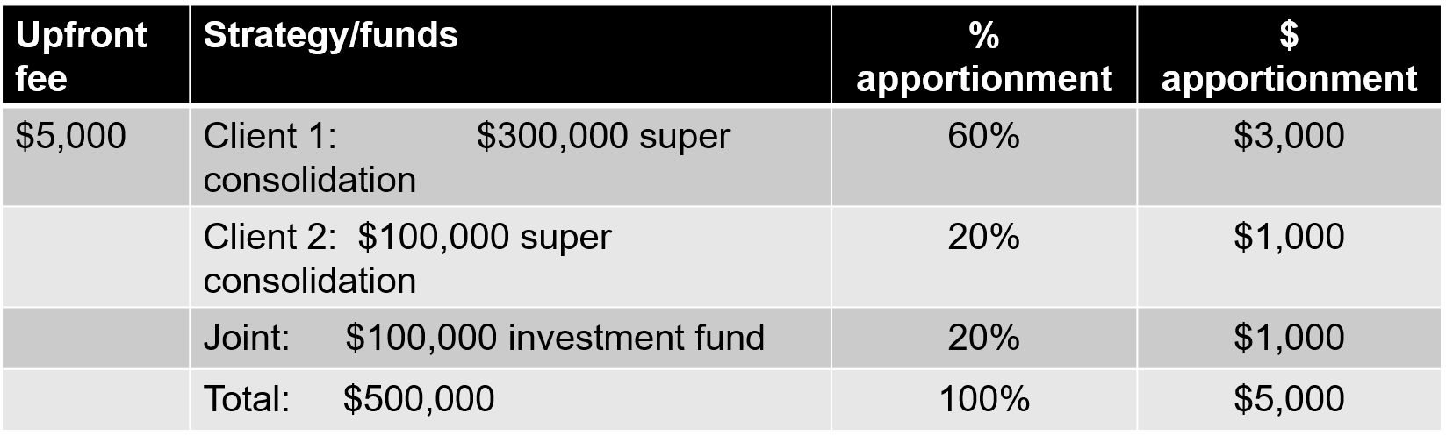
SOLE PURPOSE TEST
FUM Method

Slide 21
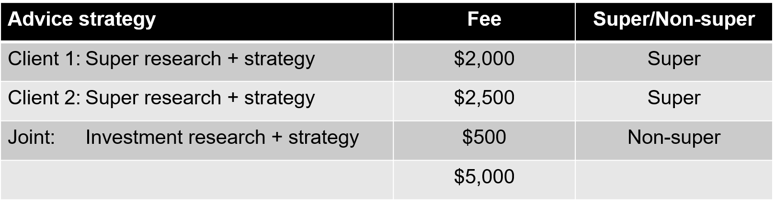
Complexity method
SOLE PURPOSE TEST

Slide 22
ALTERNATIVES
Within an SOA document, Alternatives are Mandatory. An SOA must demonstrate that you have considered other strategies and products when :
  You are making changes to your clients current financial strategy
  You are replacing one product for another
It is a requirement to document alternatives considered for EVERY recommendation made and the reason why that alternative option was discounted.
Primarily this is an ASIC requirement , however, it is also an opportunity for an adviser to really showcase their worth and highlight all the work they are doing for their clients. In most circumstances an adviser has undertaken extensive research and crunched numbers and products to get to the end result – why not show case the work you have done and use it as a selling point in your SOA presentation.
For all recommendations in your SOA you should always include at least 2 points within the title alternative strategies and at least 3 points under the title alternative products.
AND Further In all cases you must always consider the do nothing / no change option – and why you discounted this option. This should be linked to your clients financial objective

Slide 23
ALTERNATIVES
EXAMPLES
Recommendation 1 : Client is looking to review his personal insurance needs
Alternative Strategy
We considered no change / retaining your current personal insurance circumstance – this was discounted as the current policy you hold does not meet your current personal insurance needs based on the completed Insurance Needs Analysis.
We considered holding your Life/TPD outside of super- this was discounted as it would not meet your objective of limiting the impact to your cash flow where possible.
Alternative Products
I considered retaining your current XXX insurance policy- this was discounted as your current policy does not offer the level of cover that your require.
I considered the recommended insurance cover within your current policy – this was discounted as this would be much more expensive in your current policy.
I considered making the recommendation with XXX and XXX, however these were discounted as they would not insure you current occupation rating.
Recommendation 2: Moving a Superannuation accumulation to an income stream
Alternative Strategy
We considered making no change and leaving your money within the current accumulation phase of your superannuation fund - This was discounted as one of your primary objectives was to generate income and this cannot be achieved by leaving your funds as they are.
We considered a full withdrawl and using interest as an income – this was discounted as your funds would be invested in a taxable environment.
Alternative Products
I considered leaving your funds in the current product with XXX – however this was discounted as your current product is more expensive than the recommended.
I considered how the recommendation would look in the current product – however this was discounted as your current product would be more expensive and cannot offer the diversification available in the recommended.
I considered recommending alternative funds such as XXX and XXX – these were discounted as they are more expensive than the recommended

Slide 24
ALTERNATIVES
METHOD USED TO DEMONSTRATE ALTERNATIVES
The research of these alternatives can be demonstrated in the SOA as per the table below.
 | Product A - Current | Product B – Current (like for like) | Product C - Recommended | Product D – Alternative (like for like) | Product E – Alternative (like for like)
Administration Fee | $657.55 | $998.27 | $597.81 | $701.02 | $1,201.96
Expense Recovery Fee | $0.00 | $0.00 | $0 | $0 | $0
Investment Costs (MER) | $1,904.60 | $2,071.01 | $2,138.85 | $2,458.98 | $2,501.74
Membership Fee | $0.00 | $528.00 | $0 | $0 | $0
Operational Risk Reserve Levy | $35.75 | $0.00 | $40.00 | $0 | $35.00
Performance Fee | $347.10 | $239.66 | $239.66 | $512.00 | $839.66
Super Admin Fee | $0.00 | $135.68 | $89.55 | $102.55 | $0
Investment Rebate | $0.00 | $0 | $0 | $0 | $0
Total Fees | $2,945.00 | $3,972.62 | $3,105.87 | $3,774.55 | $4,578.36

Slide 25

Question Time

